Slide 1
Nerdma Hack-AI-thon

Slide 2
Table of contents
01
05
02
03
04
Artificial Intelligence
Potential of AI
AI Integration
Benefits of AI
06
07
08
Target Market
Implementation
Challenges and Considerations
Conclusion and Idea

Slide 3
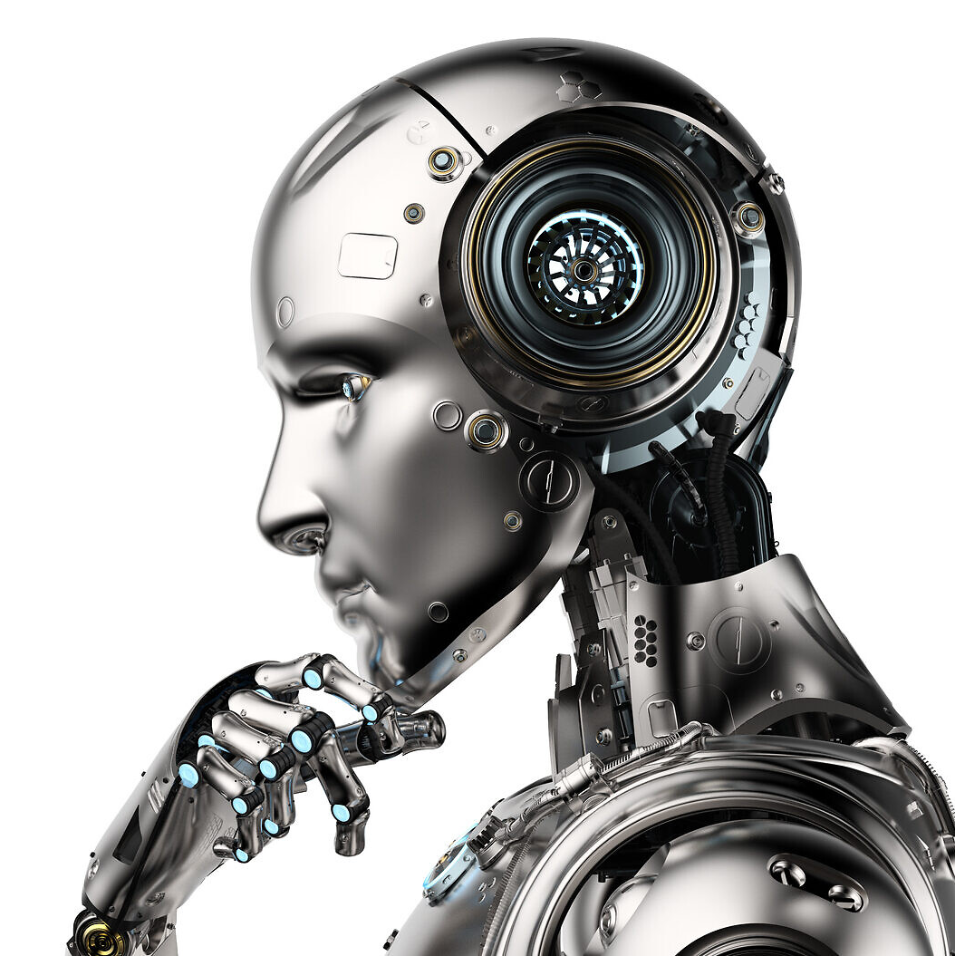
01
Artificial Intelligence

Slide 4
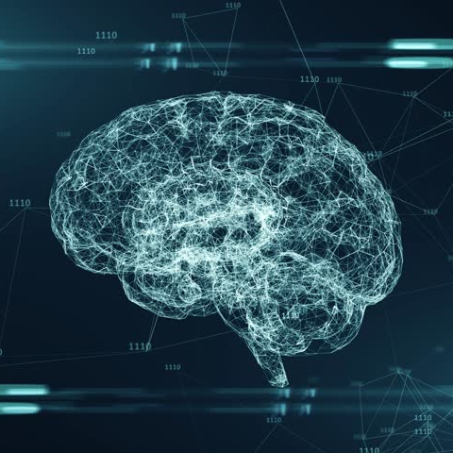
What is AI?
Artificial Intelligence, refers to the development of computer systems capable of performing tasks that typically require human intelligence. These tasks include:
Learning and problem-solving
Understanding natural language
Recognizing speech and visual patterns
Making decisions based on data
AI systems can range from narrow or weak AI, designed for specific tasks, to general or strong AI, which aims to replicate human-level intelligence across various domains.
AI has applications in numerous fields, including healthcare, finance, transportation, and entertainment. Its development raises important ethical and societal questions about the future of work, privacy, and the relationship between humans and machines.

Slide 5
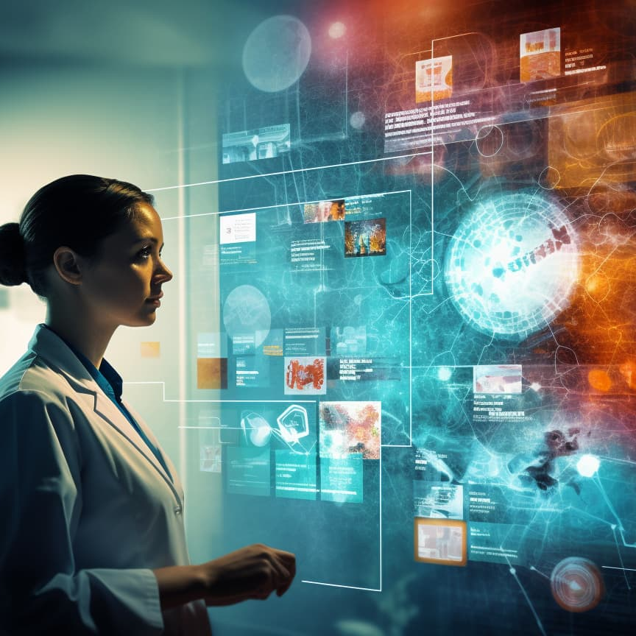
02
Potential of AI

Slide 6
Key areas where AI can make significant improvements
Healthcare
Education
Agriculture
- Early disease detection and diagnosis
- Drug discovery and development
- Personalized treatment plans
- Healthcare resource allocation
- Personalized learning experiences
- Automating administrative tasks
- Improving accessibility for students with disabilities
- Enhancing distance learning
- Precision farming techniques
- Crop yield prediction and optimization
- Pest and disease detection
- Supply chain optimization
Transportation
Cybersecurity
Manufacturing
- Traffic management and reduction
- Autonomous vehicles
- Public transit optimization
- Logistics and supply chain efficiency
- Threat detection and prevention
- Fraud detection
- Network security optimization
- Predictive maintenance
- Quality control
- Process optimization
- Supply chain management

Slide 7
Continuation…
Climate Change and Environmental Protection:
Financial Services
- Optimizing energy consumption
- Improving renewable energy systems
- Predicting and mitigating natural disasters
- Monitoring and protecting ecosystems
- Risk assessment and management
- Fraud detection
- Algorithmic trading
- Personalized financial advice
Urban Planning
Customer Service
- Smart city infrastructure
- Resource allocation
- Public safety improvements
- Chatbots and virtual assistants
- Personalized recommendations
- Sentiment analysis

Slide 8
03
AI Integration

Slide 9
Implementation strategies for AI integration in each sector
Healthcare
Education
Agriculture
- Implement AI-powered diagnostic tools
- Develop AI-assisted surgical robots
- Deploy predictive analytics for patient care
- Create AI-driven drug discovery platforms
- Implement adaptive learning platforms
- Develop AI tutoring systems
- Use AI for automated grading and feedback
- Create personalized curriculum recommendation systems
- Deploy AI-powered drones for crop monitoring
- Implement smart irrigation systems
- Use AI for soil health analysis and crop rotation planning
- Develop predictive models for harvest optimization
Transportation
Cybersecurity
Manufacturing
- Implement AI traffic management systems
- Develop autonomous vehicle technology
- Use AI for predictive maintenance in public transit
- Create AI-powered route optimization for logistics
- Deploy AI-powered threat detection systems
- Implement automated incident response platforms
- Use AI for network anomaly detection
- Develop AI-driven penetration testing tools
- Implement AI-powered quality control systems
- Deploy predictive maintenance platforms
- Use AI for supply chain optimization
- Develop digital twin technology for process improvement

Slide 10
Continuation…
Climate Change and Environmental Protection:
Financial Services
- Utilize AI for climate modeling and prediction
- Implement smart grid systems for energy optimization
- Develop AI-powered recycling systems
- Use AI for wildlife conservation and habitat monitoring
- Implement AI-driven risk assessment models
- Deploy automated trading algorithms
- Use AI for fraud detection and prevention
- Develop robo-advisors for personalized financial planning
Urban Planning
Customer Service
- Implement AI-powered traffic flow optimization
- Use AI for predictive maintenance of infrastructure
- Deploy smart energy management systems
- Develop AI-driven urban development simulations
- Implement AI chatbots and virtual assistants
- Use AI for sentiment analysis in customer feedback
- Deploy predictive models for customer behavior
- Develop AI-powered personalization engines

Slide 11
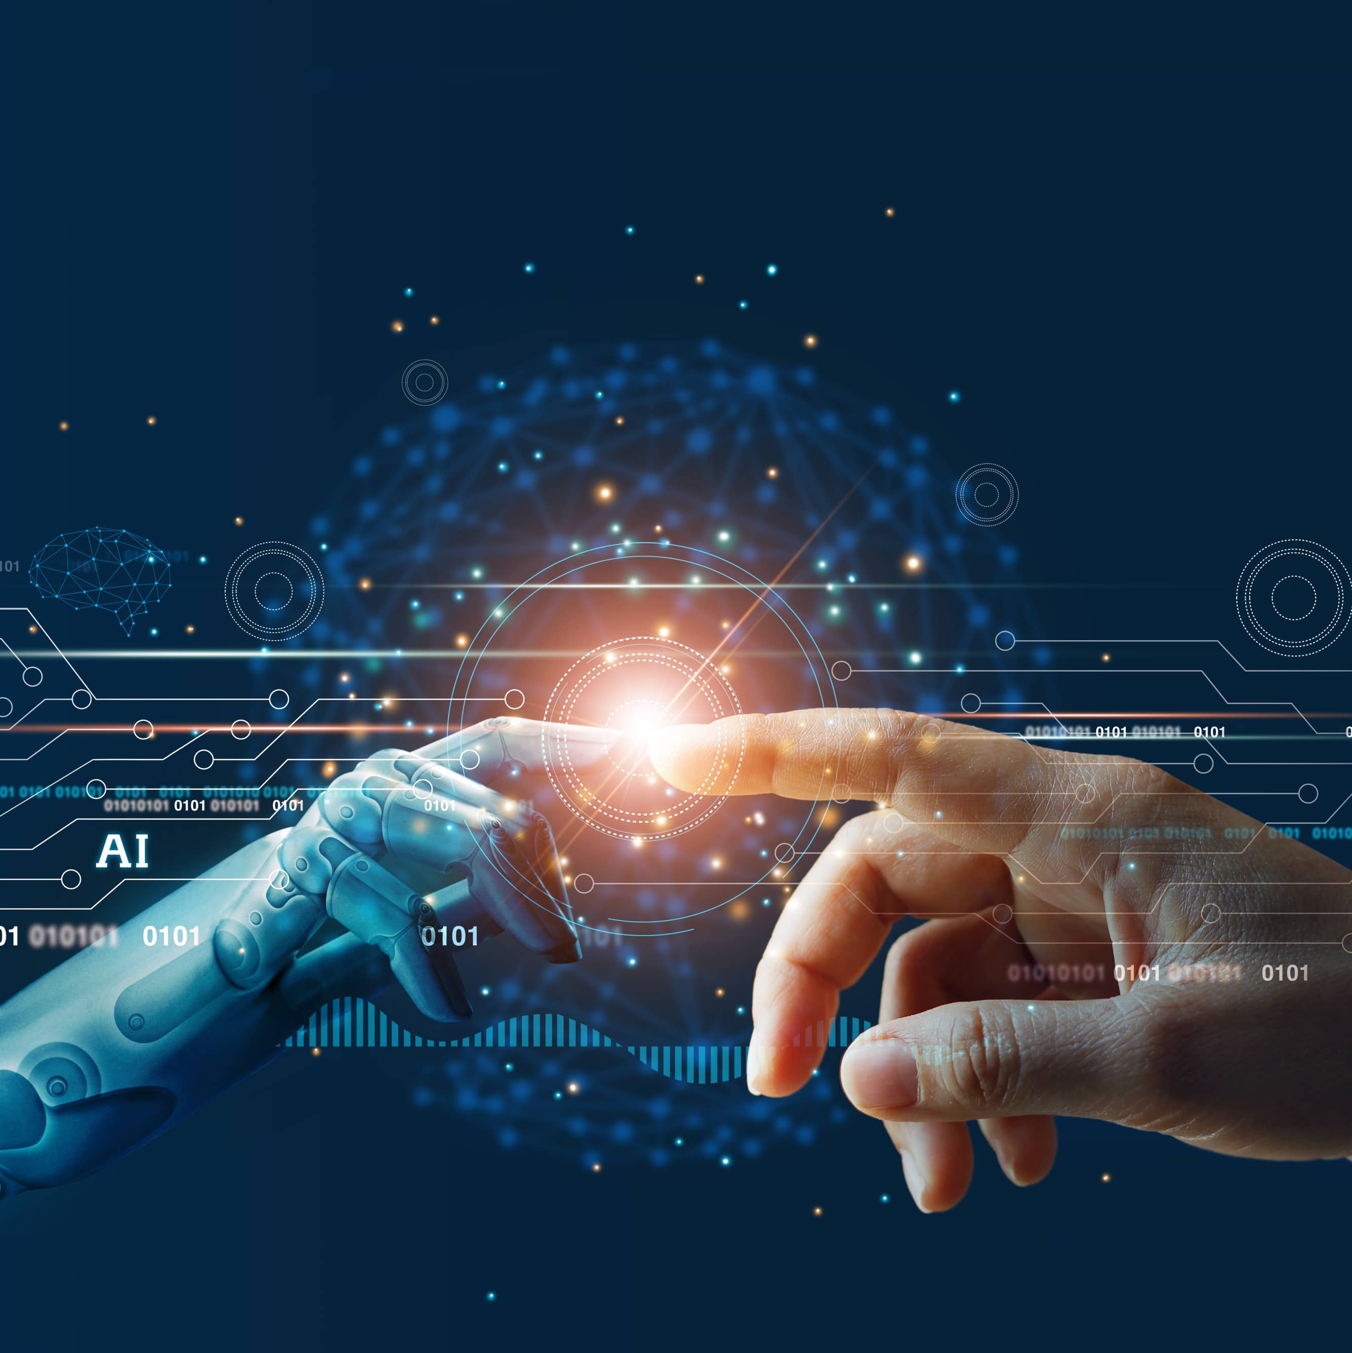
04
Benefits of AI

Slide 12
AI technology offers benefits for a wide range of industries, but some target markets are particularly well-suited to leverage AI to enhance performance and efficiency
1
2
Manufacturing: AI can optimize production processes, predict equipment failures, and improve quality control.
Customer service: AI-powered chatbots can handle routine inquiries, freeing up human agents for more complex issues.
Healthcare: AI can analyze medical data to identify diseases early, personalize treatment plans, and assist with drug discovery.
Finance: AI can automate fraud detection, optimize investment decisions, and provide personalized financial advice.
Retail: AI can personalize product recommendations, optimize pricing strategies, and improve inventory management.

Slide 13
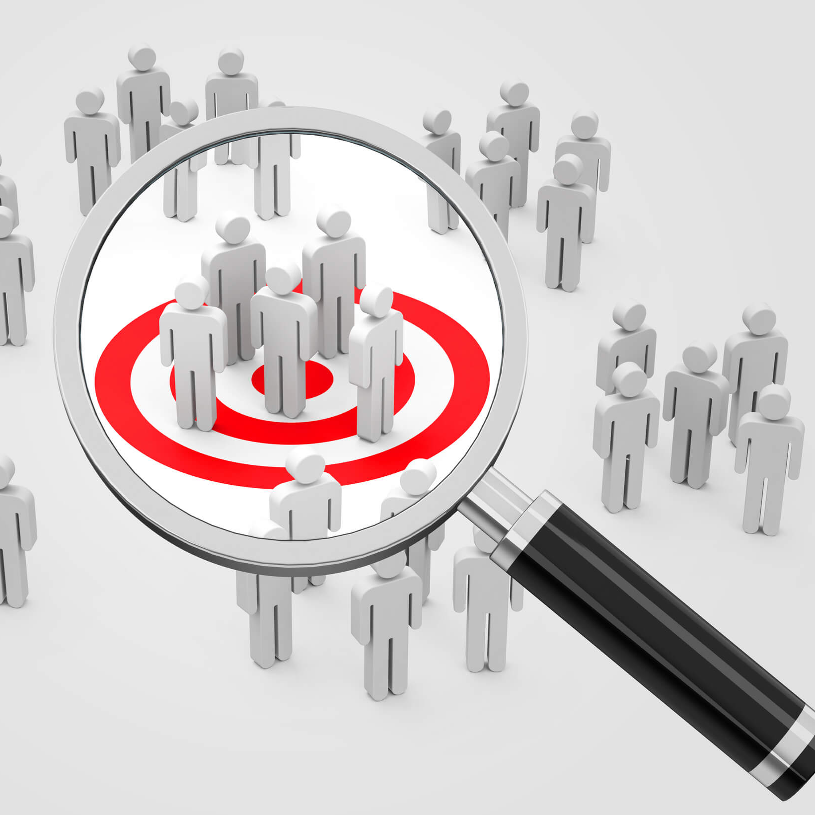
05
Target Market

Slide 14
Analysis of prime target markets
Healthcare
Financial Services
Manufacturing
Large hospitals and healthcare networks
- Pharmaceutical companies
- Medical research institutions
- Health insurance providers
Key benefits: Improved diagnostics, personalized treatment plans, drug discovery acceleration, and operational efficiency.
- Investment banks
- Insurance companies
- Fintech startups
- Wealth management firms
Key benefits: Enhanced risk assessment, fraud detection, algorithmic trading, and personalized financial advice.
- Automotive industry
- Electronics manufacturers
- Aerospace companies
- Industrial equipment producers
Key benefits: Predictive maintenance, quality control optimization, supply chain management, and process automation.

Slide 15
Continuation…
Retail and E-Commerce
Transportation and Logistics
Energy and Utilities
- Large online retailers
- Brick-and-mortar chains
- Omnichannel retailers
- Consumer goods companies
Key benefits: Demand forecasting, personalized marketing, inventory management, and supply chain optimization.
- Shipping and freight companies
- Ride-sharing platforms
- Public transit authorities
- Airlines and airports
Key benefits: Route optimization, predictive maintenance, demand forecasting, and autonomous vehicle development.
- Power generation companies
- Oil and gas industry
- Renewable energy providers
- Smart grid operators
Key benefits: Energy demand prediction, grid optimization, predictive maintenance, and resource exploration.

Slide 16
Continuation…
Agriculture
Telecommunications
Cybersecurity
- Large-scale farming operations
- Agribusiness corporations
- Precision agriculture technology providers
- Food processing companies
Key benefits: Crop yield optimization, pest management, resource allocation, and supply chain efficiency.
- Mobile network operators
- Internet service providers
- Satellite communication companies
Key benefits: Network optimization, predictive maintenance, customer churn prevention, and personalized services.
- Managed security service providers
- Large enterprises with significant digital assets
- Government agencies
- Financial institutions
Key benefits: Threat detection, automated incident response, fraud prevention, and risk assessment.

Slide 17
Continuation…
Education
- EdTech companies
- Large universities and school districts
- Online learning platforms
- Corporate training providers
Key benefits: Personalized learning experiences, automated grading, student performance prediction, and course optimization

Slide 18
These target markets are particularly well-suited for AI integration due to their:
When approaching these markets, it's crucial to consider:
1. Large data volumes and variety
2. Complex decision-making processes
3. High potential for efficiency gains and cost savings
4. Competitive landscapes that reward innovation
5. Existing technological infrastructure to support AI implementation
- Regulatory compliance requirements specific to each industry
- The need for explainable AI in sensitive decision-making processes
- Integration challenges with existing systems and workflows
- The importance of demonstrating clear ROI and performance improvements
- Potential resistance to change and the need for change management strategies

Slide 19
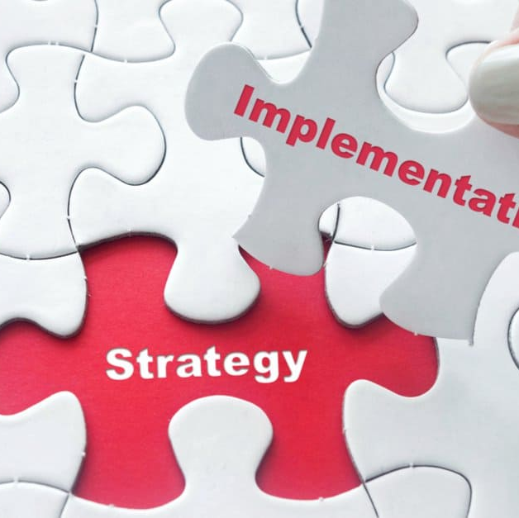
06
Implementation

Slide 20
Implementation of AI across sectors
Programming Languages
Code
Python, R, Java, C++ and Julia.
APIs and Framework
TensorFlow, PyTorch, Keras, scikit-learn, OpenAI API, IBM Watson Suite, Google Cloud AI, Microsoft Azure AI and Amazon SageMaker.
Framework
Hardware
Devices and Hardware
GPUs, TPUs, FPGAs, Edge AI devices, IoT sensors, Drones, Robotics platforms, Smart cameras and Wearable devices.

Slide 21
Implementation Sector-Specific Examples:
Healthcare
Climate Change
Education
- DICOM toolkit for medical imaging
- HL7 FHIR for healthcare data interoperability
- Earth Engine API for geospatial analysis
- CMIP (Coupled Model Intercomparison Project) data for climate modeling
- Learning Management System (LMS) APIs like Canvas API
- Natural Language Processing APIs for language learning applications
Argriculture
Transportation
Cybersecurity
- John Deere API for agricultural machinery data
- Agromonitoring API for crop and weather monitoring
- HERE Maps API for location and routing services
- OpenALPR for license plate recognition
- MITRE ATT&CK framework API for threat intelligence
- VirusTotal API for malware analysis

Slide 22
Continuation…
Manufacturing
Financial Services
- OPC UA (Open Platform Communications Unified Architecture) for industrial IoT
- MTConnect for manufacturing equipment data exchange
- Plaid API for financial data aggregation
- Blockchain APIs for cryptocurrency and smart contract applications
Urban Planning
Customer Service
- OpenStreetMap API for geospatial data
- CitySDK for city-related data and services
- Dialogflow for building conversational interfaces
- Zendesk API for customer support integrations

Slide 23

07
Challenages and Considerations

Slide 24
Implementation Sector-Specific Examples:
Data Privacy and Security
Ethical Concerns
Regulatory Compliance
- Protecting sensitive personal information, especially in healthcare and financial services
- Ensuring data sovereignty and compliance with regulations like GDPR
- Preventing unauthorized access and data breaches
- Addressing bias in AI algorithms and datasets
- Ensuring transparency and explainability of AI decision-making
- Balancing automation with human oversight and intervention
- Navigating complex and evolving regulations across different jurisdictions
- Ensuring AI systems meet industry-specific standards and certifications
- Addressing liability issues in case of AI errors or failures
Technical Challenges
Workforce Transformation
Cost and ROI
- Integrating AI with legacy systems and infrastructure
- Ensuring scalability and reliability of AI solutions
- Managing the computational resources required for AI processing
- Reskilling and upskilling employees to work alongside AI systems
- Managing potential job displacement due to automation
- Cultivating AI literacy across organizations
- Justifying high initial investments in AI technology and infrastructure
- Demonstrating tangible returns on AI investments
- Managing ongoing costs for AI maintenance and upgrades

Slide 25
Continuation…
Data Quality and Availability
Trust and Adoption
Interdisciplinary Collaboration
- Ensuring access to large, high-quality datasets for training AI models
- Addressing data silos and interoperability issues
- Managing data labeling and preparation processes
- Building public trust in AI-driven systems, especially in sensitive areas like healthcare
- Overcoming resistance to change within organizations
- Ensuring user-friendly interfaces for AI tools to encourage adoption
- Bridging gaps between AI experts, domain specialists, and end-users
- Fostering collaboration between academia, industry, and government
- Balancing technical capabilities with real-world applicability
Long-term Sustainability
Accountability and Governance
Cultural and Social Impact
- Ensuring AI systems remain effective as contexts change over time
- Managing the environmental impact of energy-intensive AI computations
- Developing strategies for continuous improvement and adaptation of AI systems
- Establishing clear lines of responsibility for AI-driven decisions
- Developing governance frameworks for AI deployment and monitoring
- Implementing mechanisms for auditing and validating AI systems
- Addressing potential societal changes due to widespread AI adoption
- Considering the impact on different demographic groups and communities
- Balancing efficiency gains with potential negative societal consequences

Slide 26

08
Conclusion and Idea

Slide 27
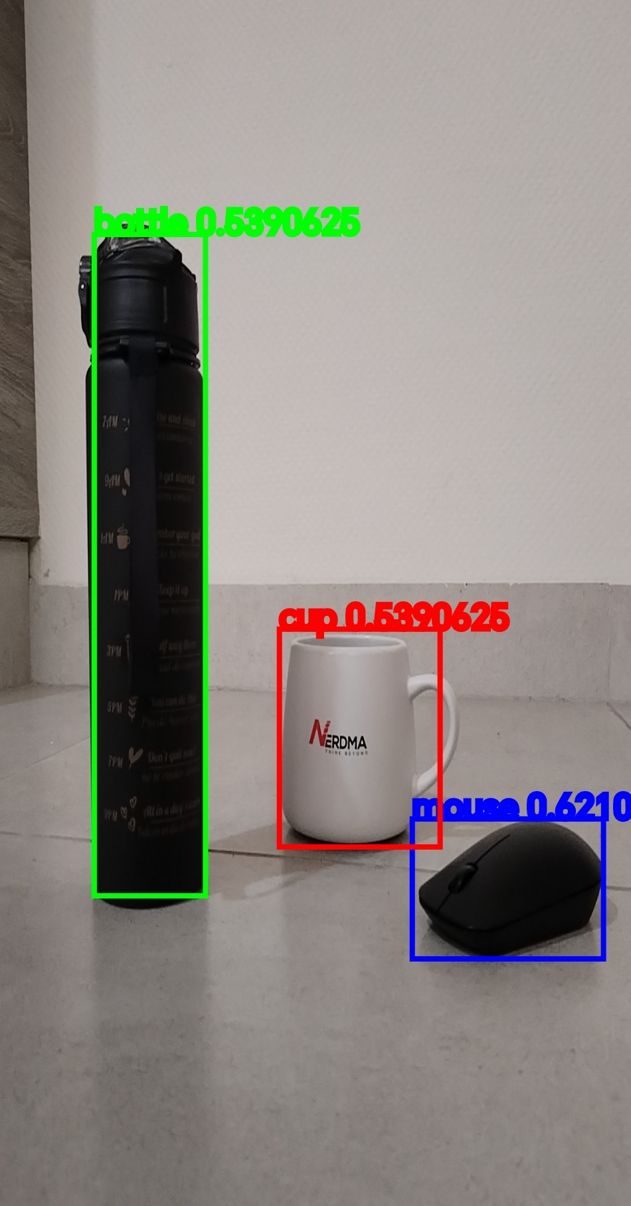
Agricultural Detection
Visuals
Features
App is designed to highlight object and label it
Detect and depreciate between various object like weeds or crops
Price
Users
Free to use
First time gardeners to assist in knowing different types of plants
Availability
Updates
Available on android as beta then final will release on both iOS & Android
App and ML model will have regular updates

Slide 28
Roadmap infographic
Initiative | Objective | Jan | Feb | Mar | Apr | May | Jun | Jul | Aug | Sep | Oct | Nov | Dec
Understanding | Analyze and understand the needs of your target audience
Conduct research | Research existing products in the industry and analyze how successful they are
Brainstorm ideas | Generate ideas based on user feedback and research findings
Develop a prototype | Create a basic version of the product to show investors
Test for usability | Put the prototype through rigorous testing processes to ensure that it meets user requirements
Analyze feedback | Understand the opinion of the users who tried your product

Slide 29
729,110,000
Number of artificial intelligence (AI) tool users globally from 2020 to 2030

Slide 30
AI Tool Users Globally Statistics
2021
2022
2023
2024
154.26 million
201.38 million
254.78 million
314.38 million

Slide 31
Timeline of your presentation
Explain Artificial Intelligence
Discuss potential of Artificial Intelligence
Explain integration of AI
Discuss the benefits of AI
Discuss variuos target markets for AI integration
Process of implementing AI
Discuss Challenges and Considerations of using AI
Conclusion and Idea

Slide 32
Thanks!
Do you have any questions?
achmantm919@gmail.com
+27 71 394 9390
andybvuma787@gmail.com
+27 69 125 5585

